Slide 1
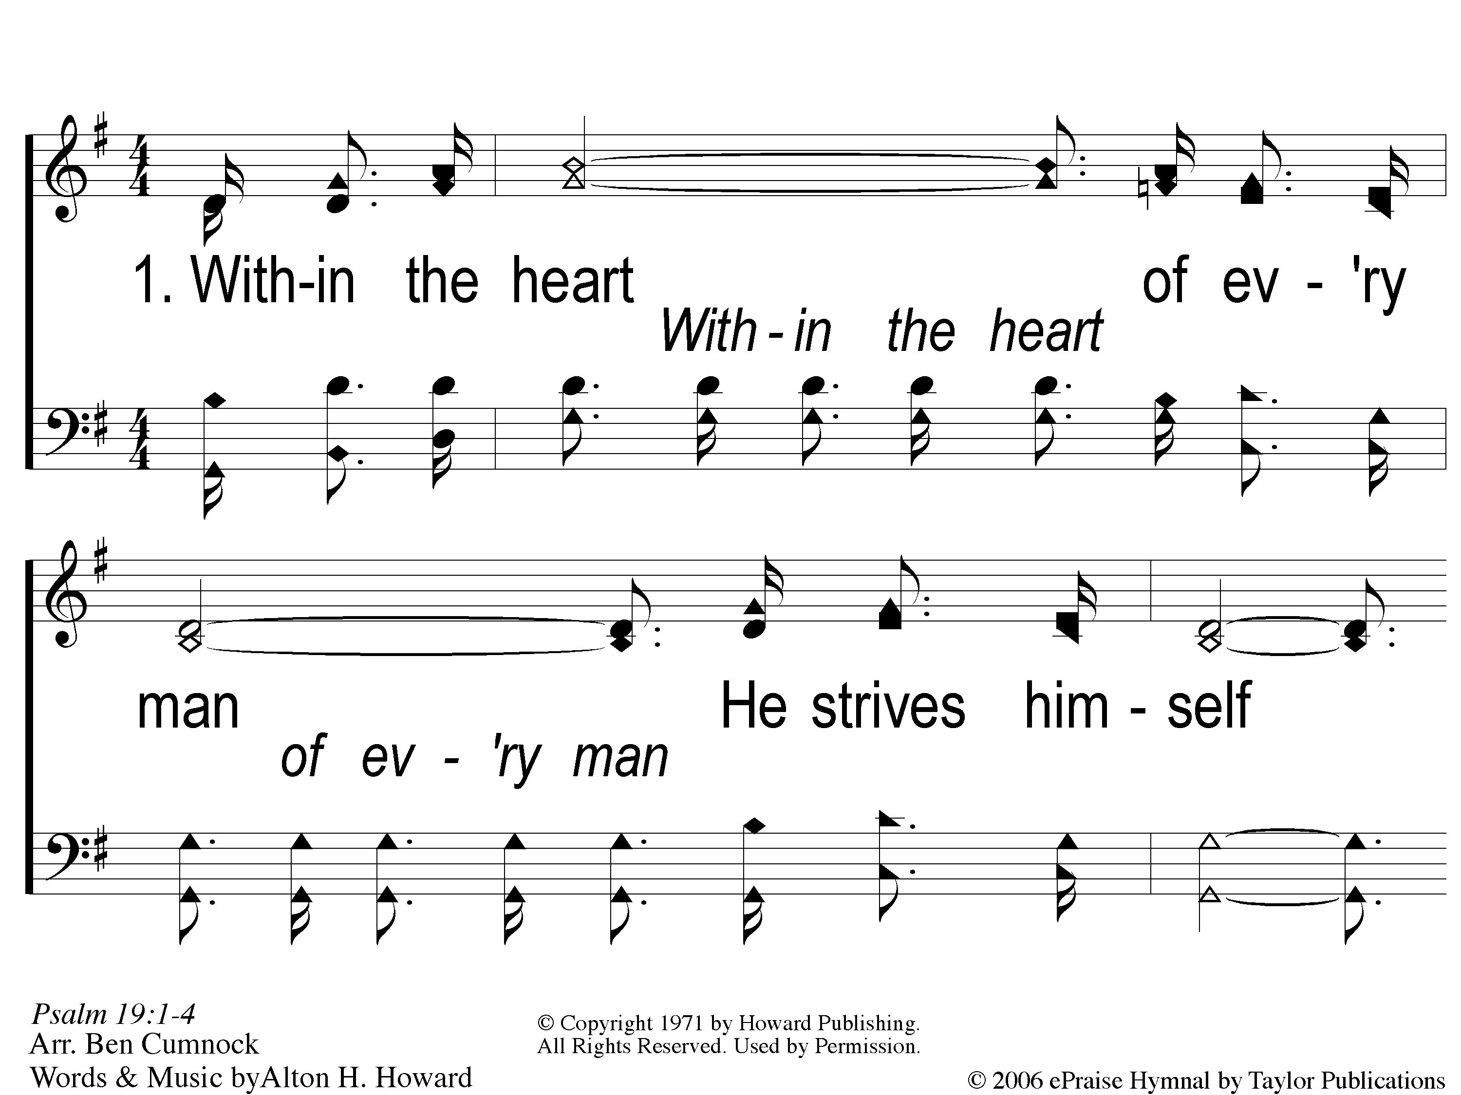
1-1 God Still Lives
God Still Lives
140

Slide 2
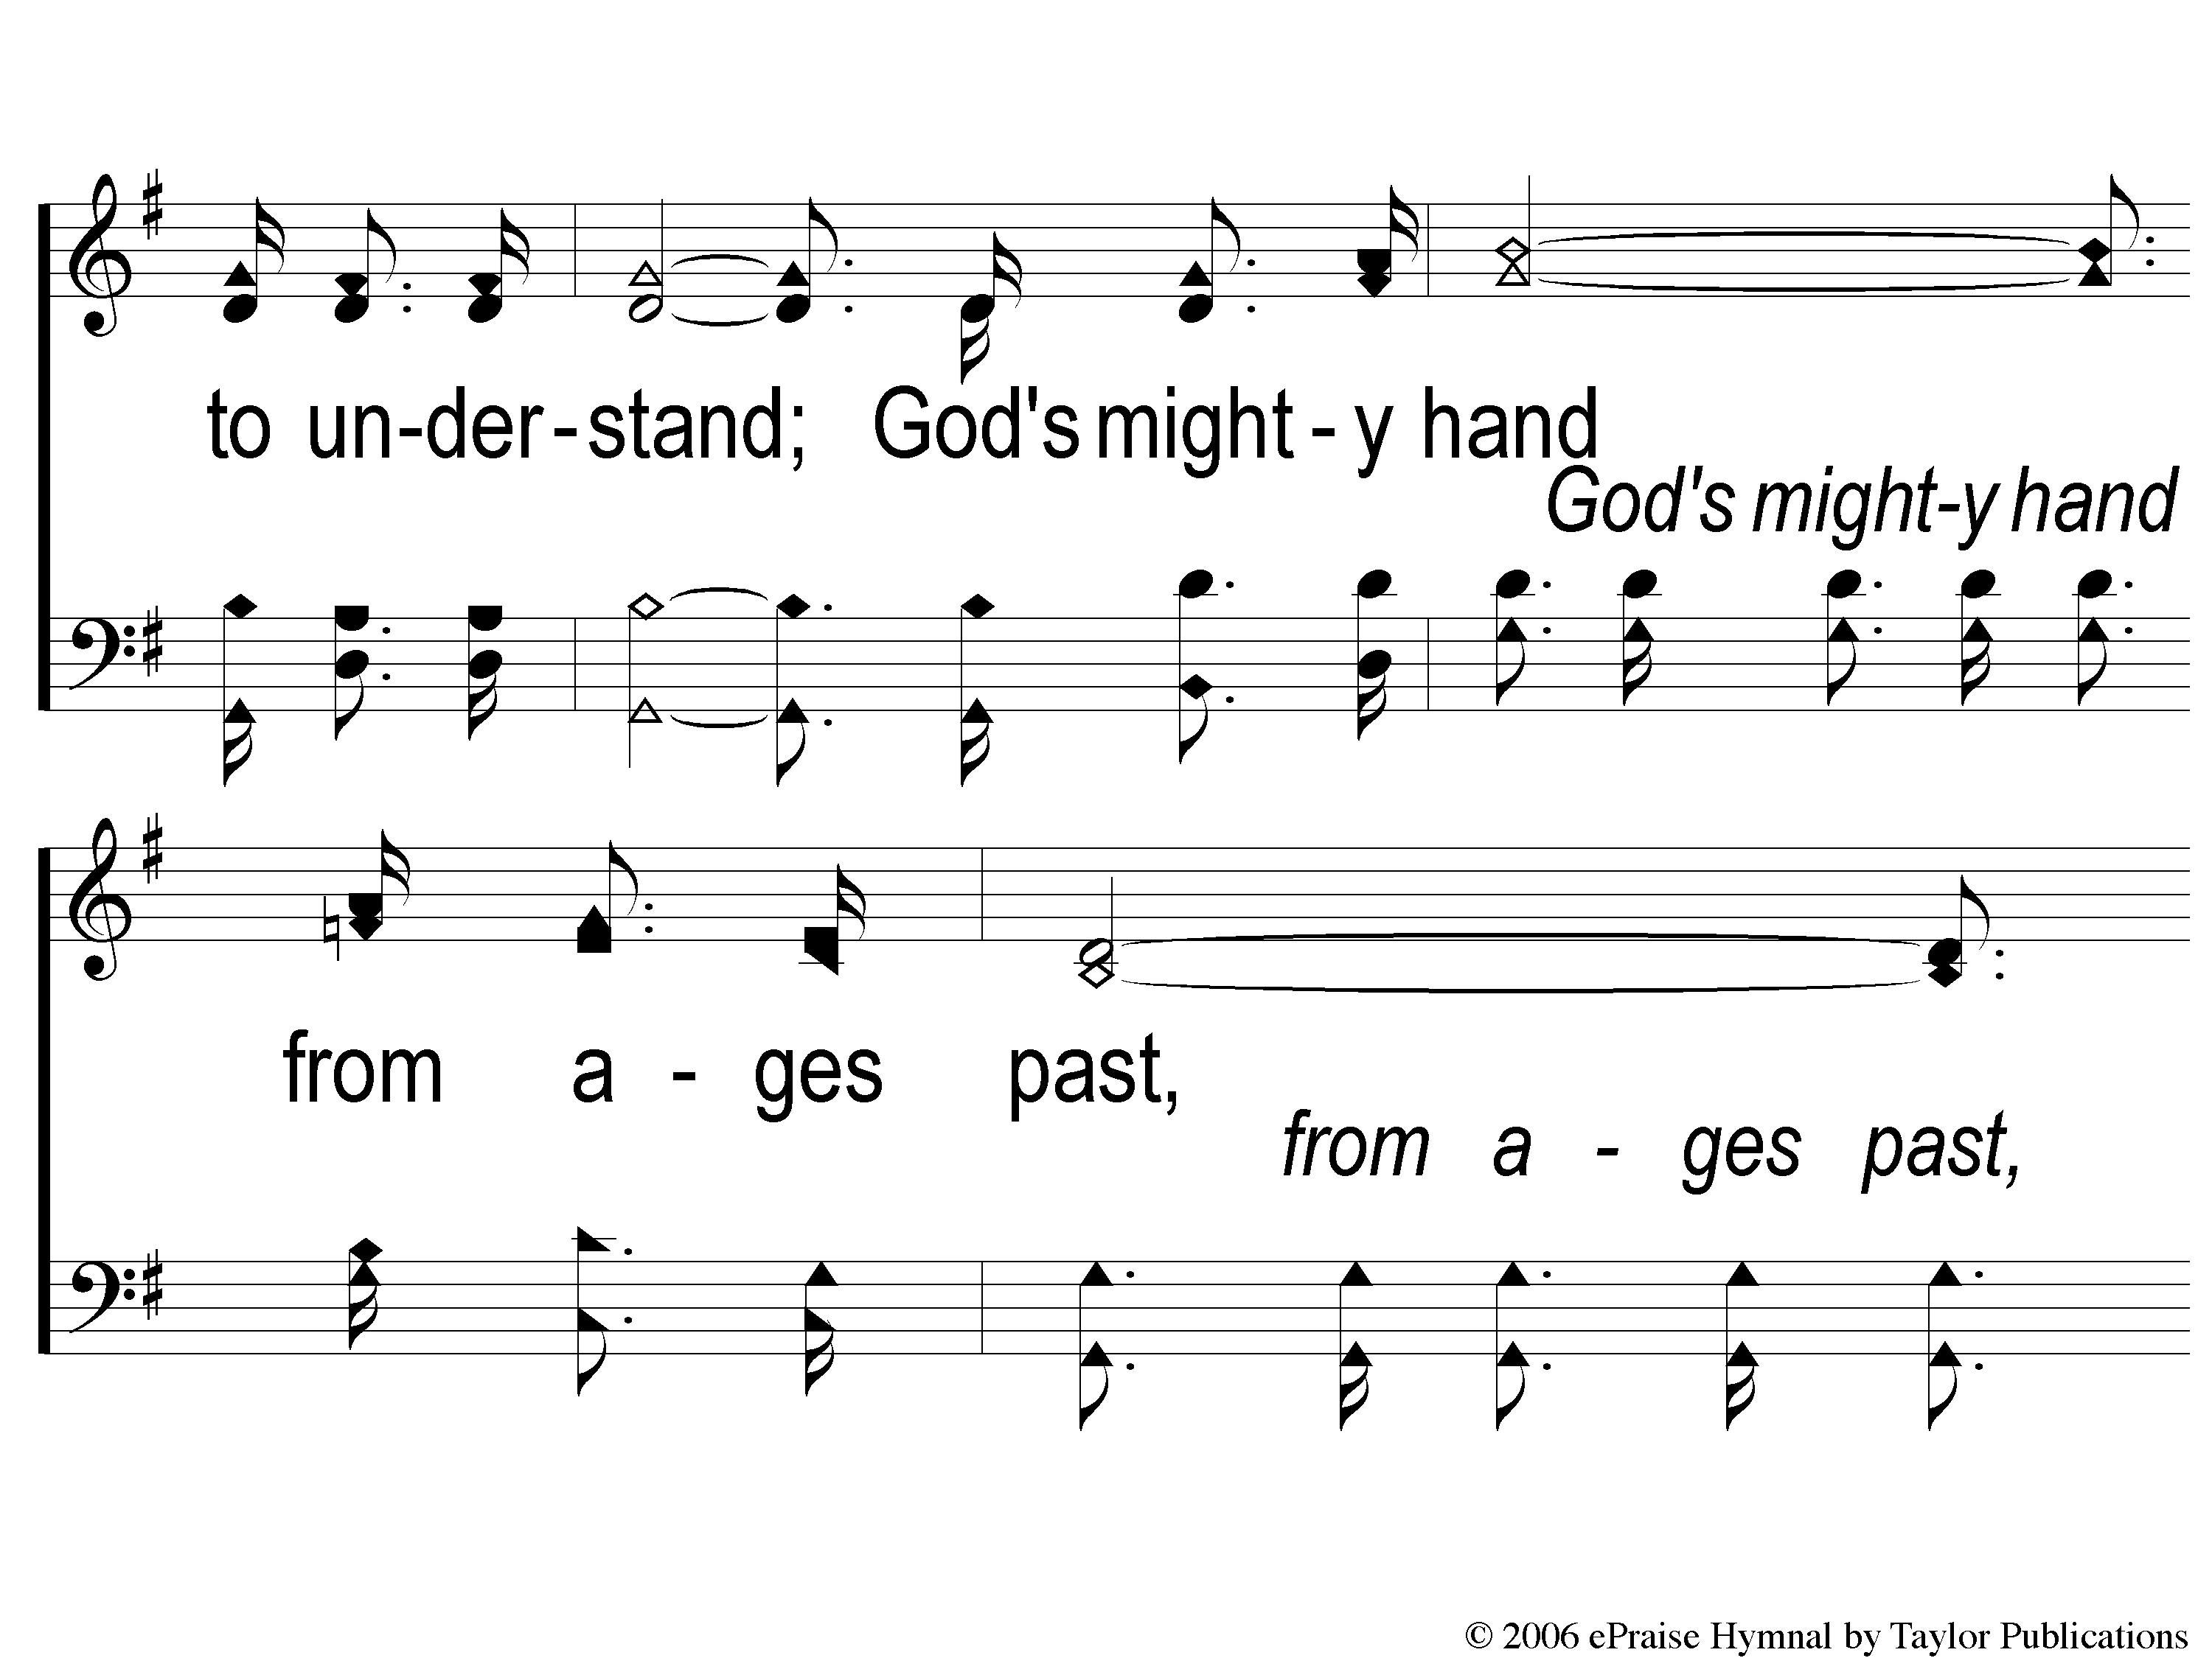
1-2 God Still Lives
God Still Lives
140

Slide 3
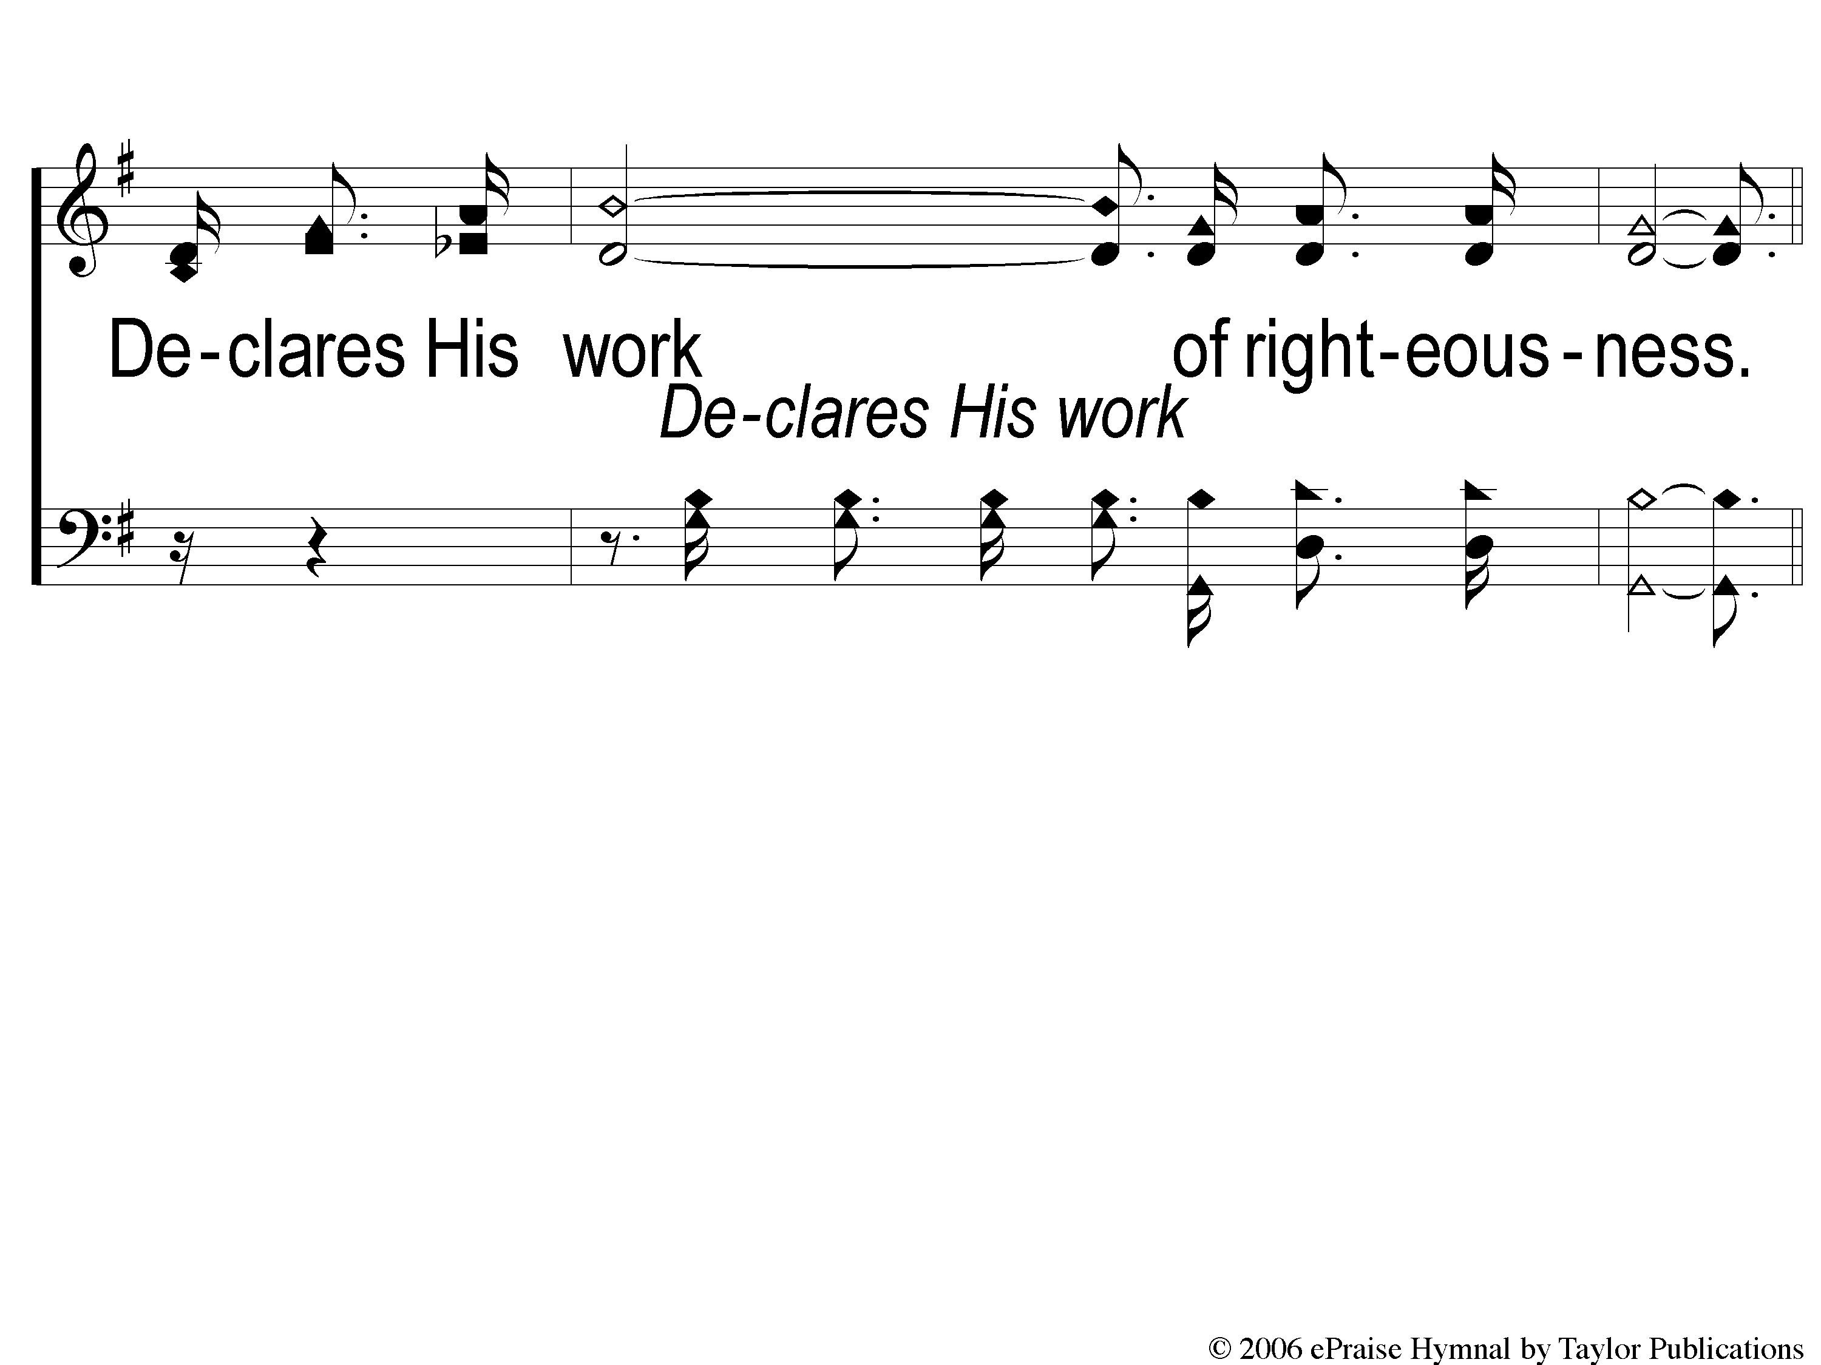
1-3 God Still Lives
God Still Lives
140

Slide 4
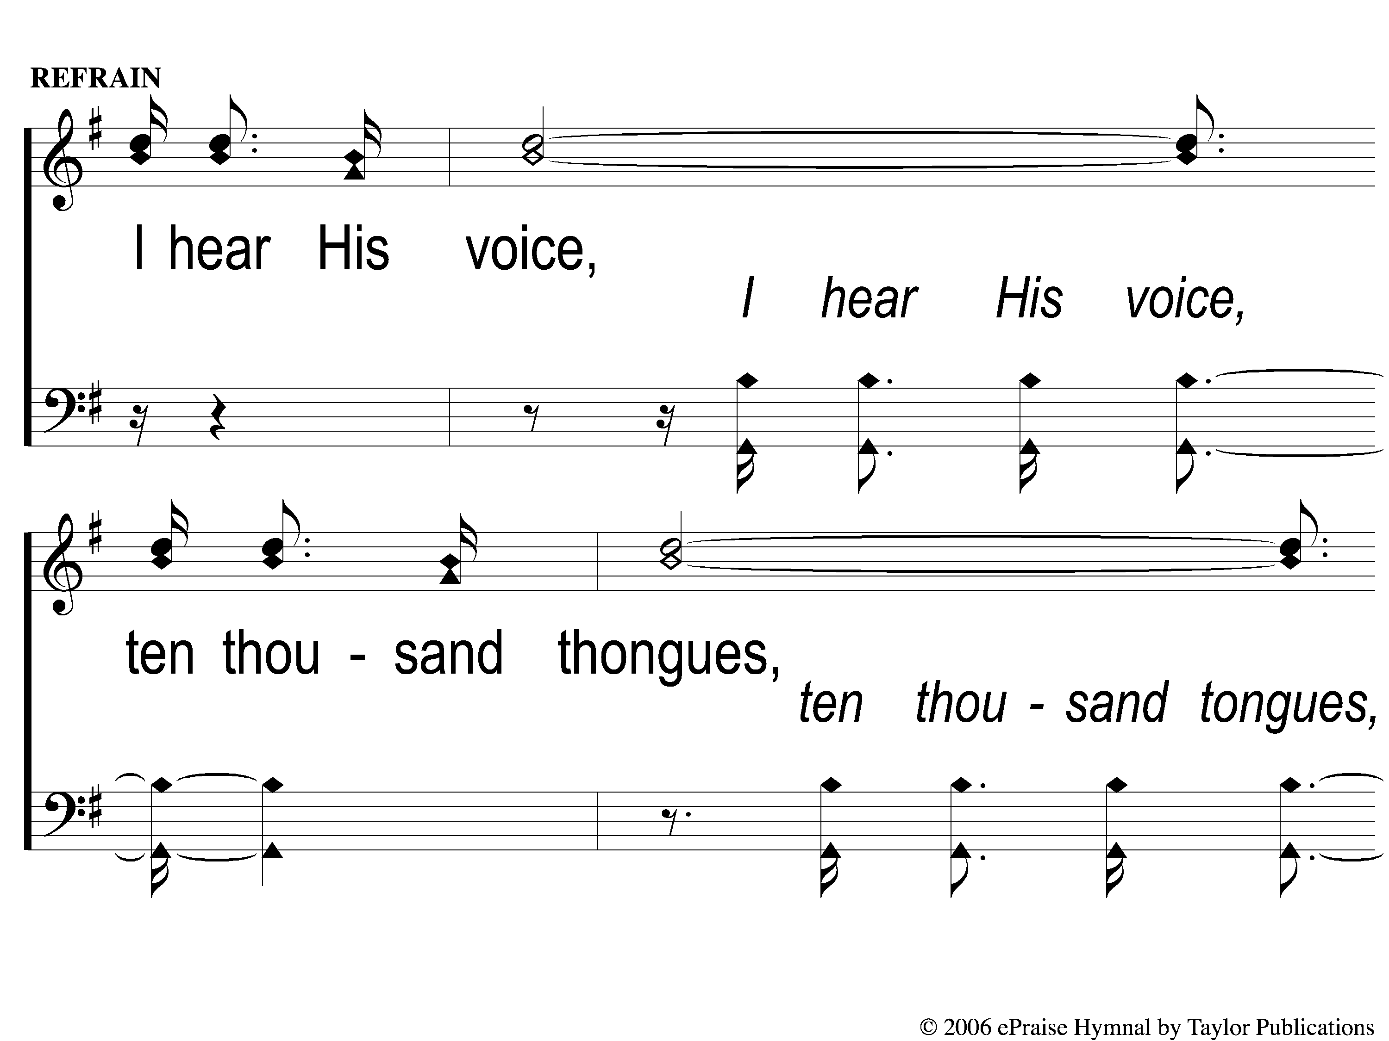
C-1 God Still Lives
God Still Lives
140

Slide 5
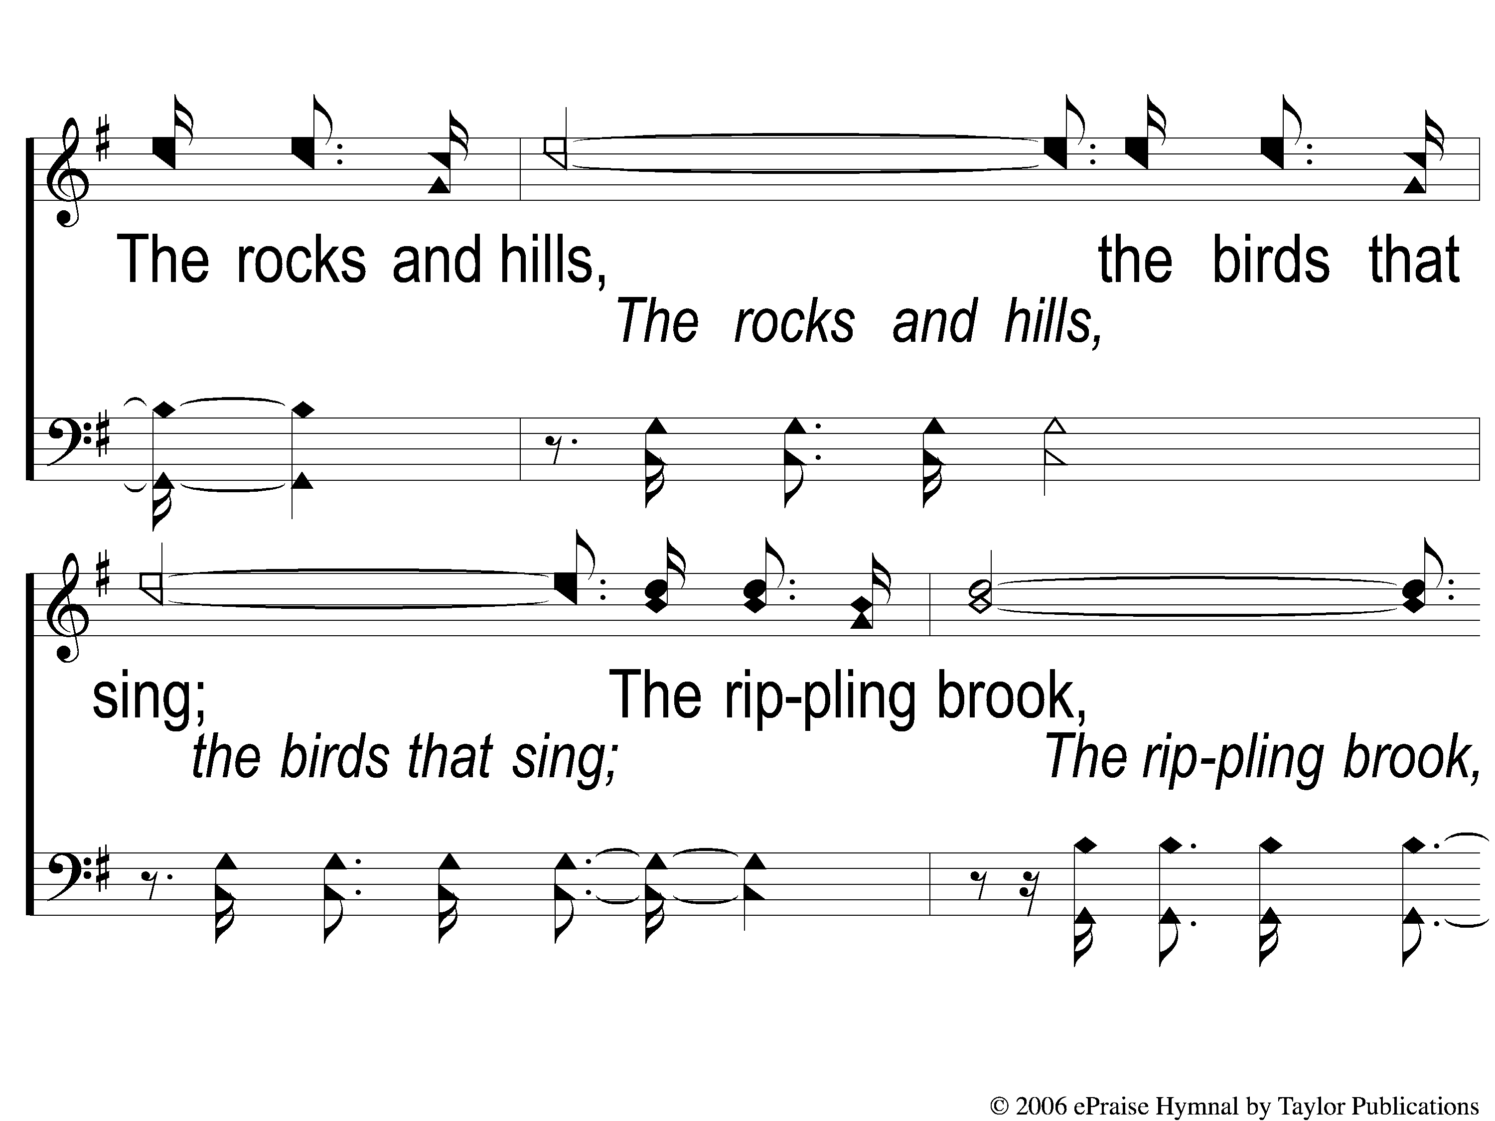
C-2 God Still Lives
God Still Lives
140

Slide 6
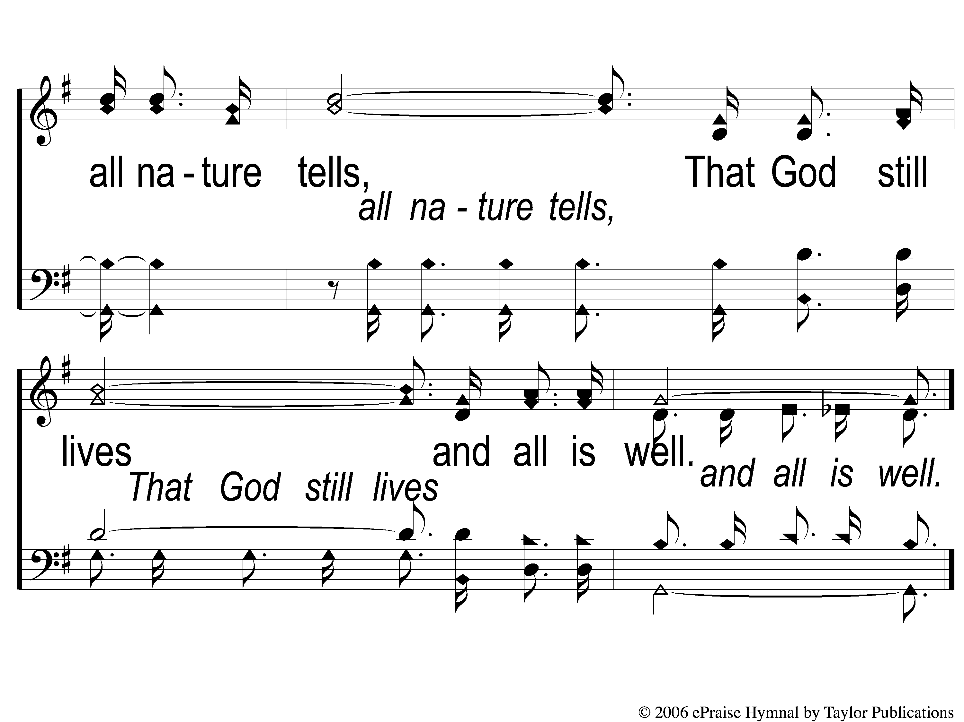
C-3 God Still Lives
God Still Lives
140

Slide 7
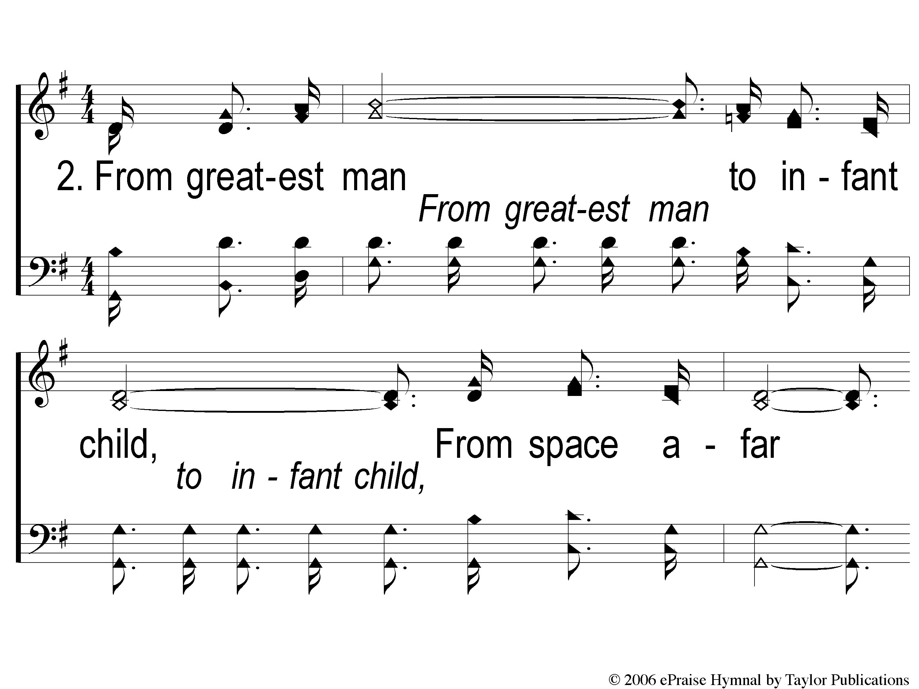
2-1 God Still Lives
God Still Lives
140

Slide 8
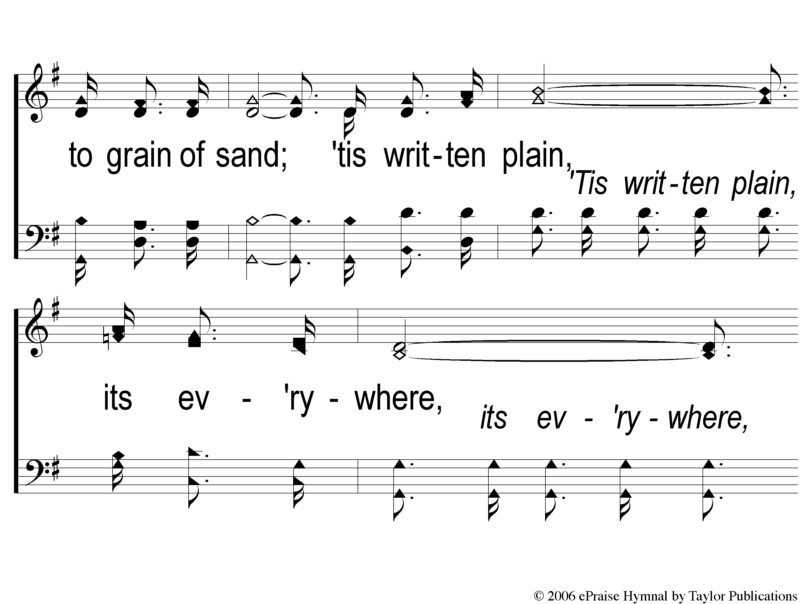
2-2 God Still Lives
God Still Lives
140

Slide 9
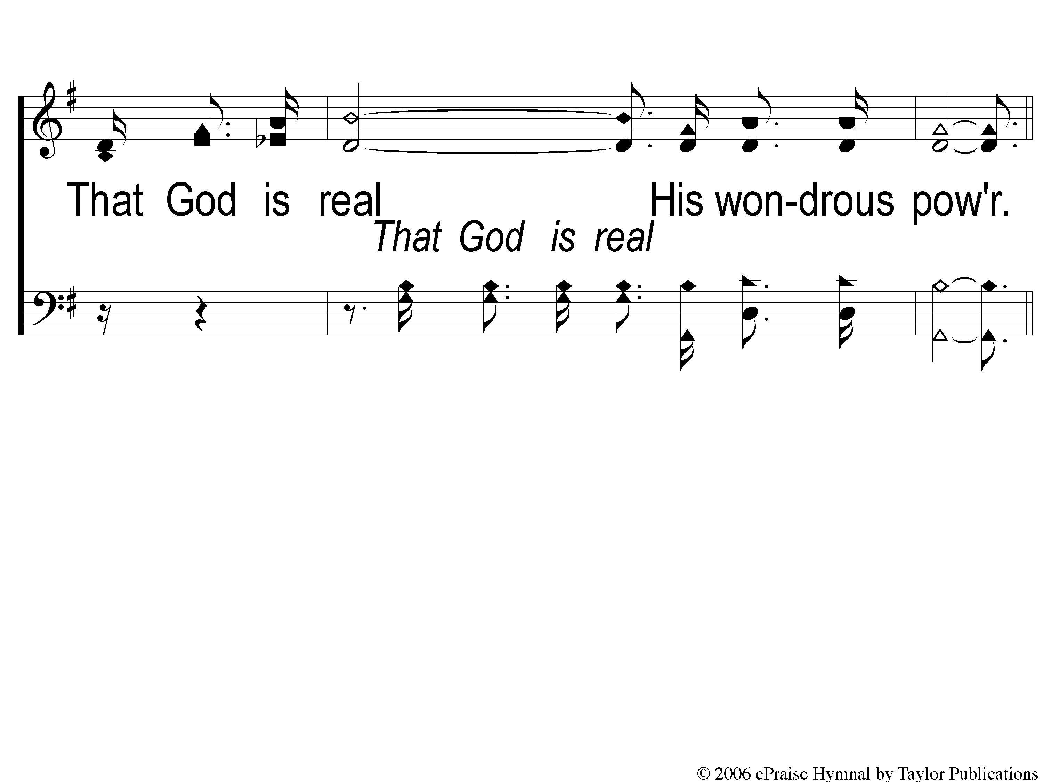
2-3 God Still Lives
God Still Lives
140

Slide 10
C-1 God Still Lives
God Still Lives
140

Slide 11
C-2 God Still Lives
God Still Lives
140

Slide 12
C-3 God Still Lives
God Still Lives
140

Slide 13
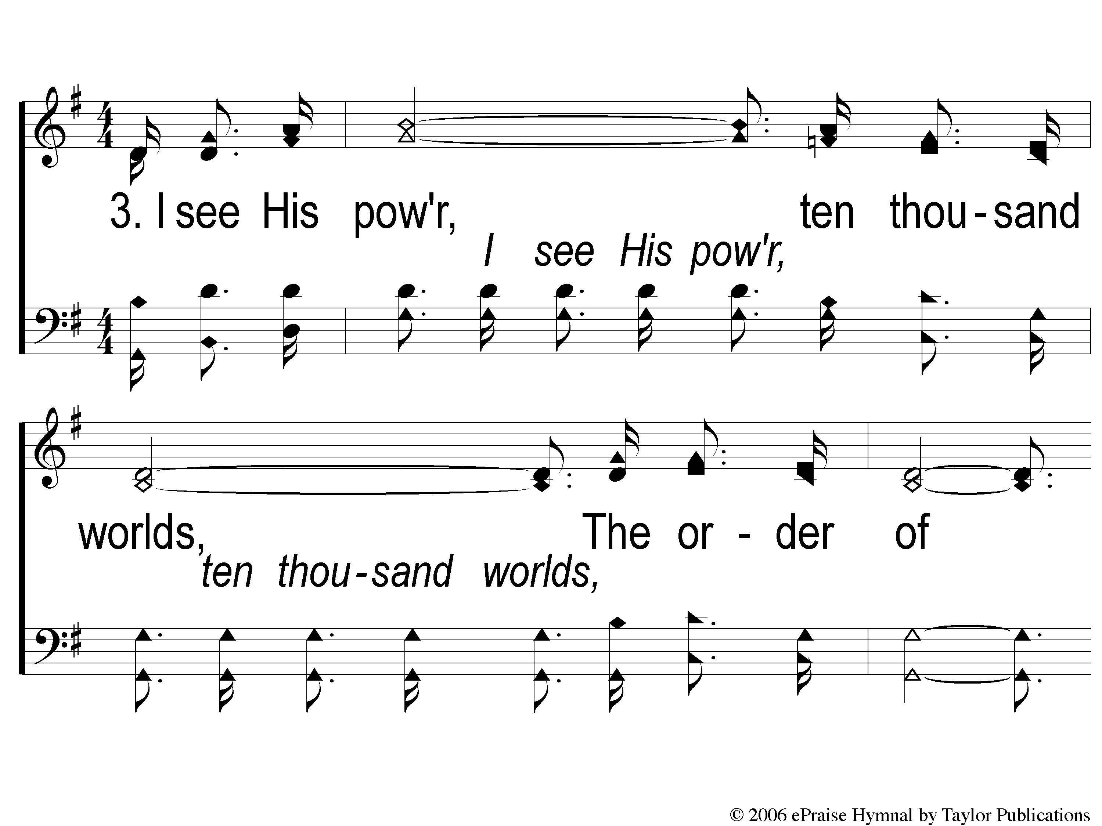
3-1 God Still Lives
God Still Lives
140

Slide 14
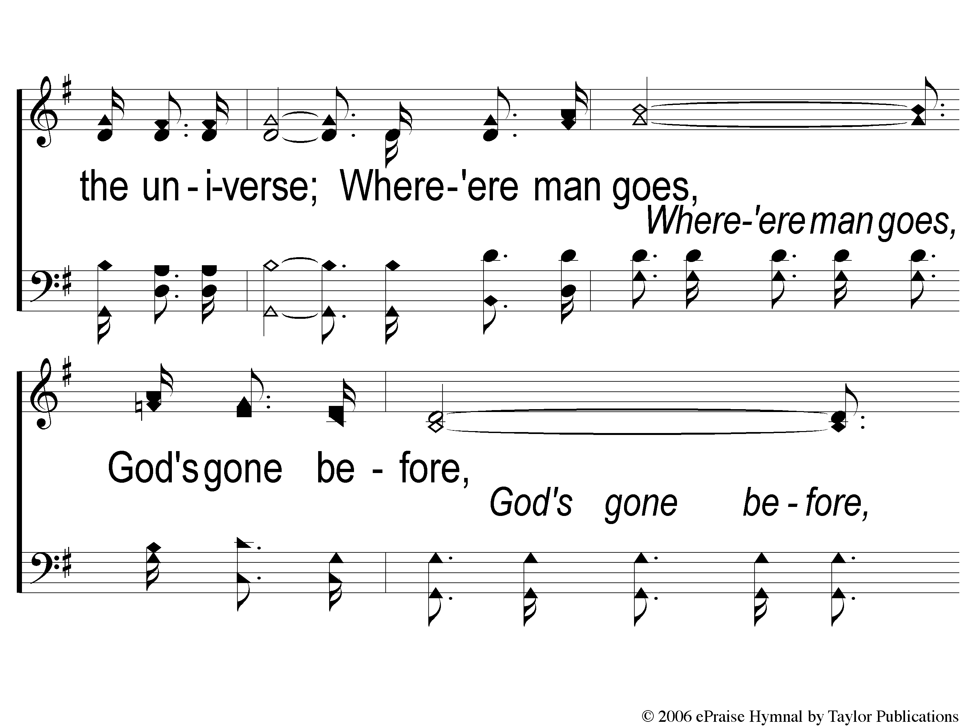
3-2 God Still Lives
God Still Lives
140

Slide 15
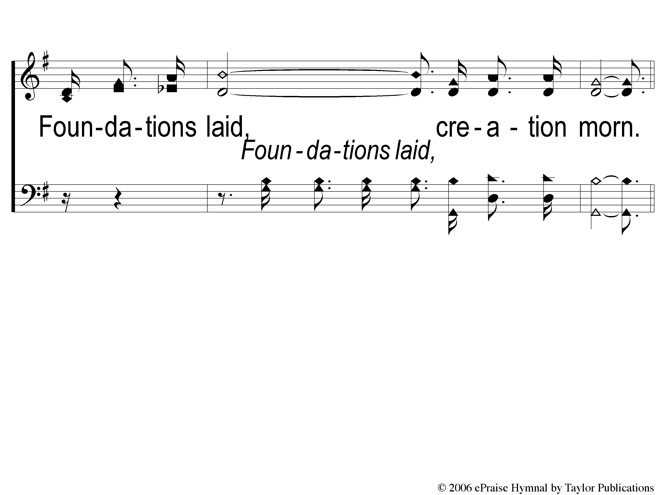
3-3 God Still Lives
God Still Lives
140

Slide 16
C-1 God Still Lives
God Still Lives
140

Slide 17
C-2 God Still Lives
God Still Lives
140

Slide 18
C-3 God Still Lives
God Still Lives
140

Slide 19
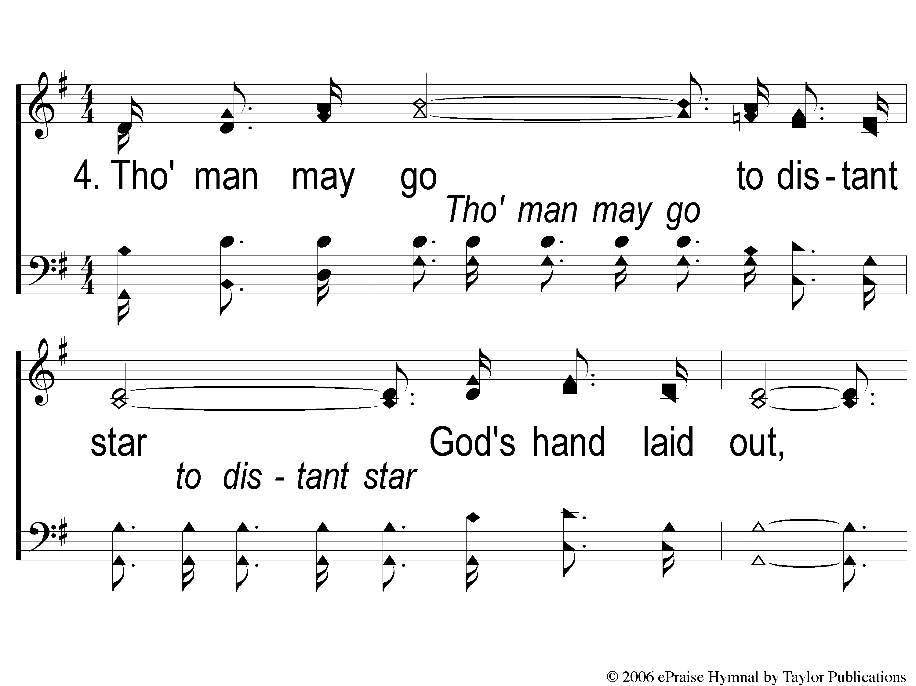
4-1 God Still Lives
God Still Lives
140

Slide 20
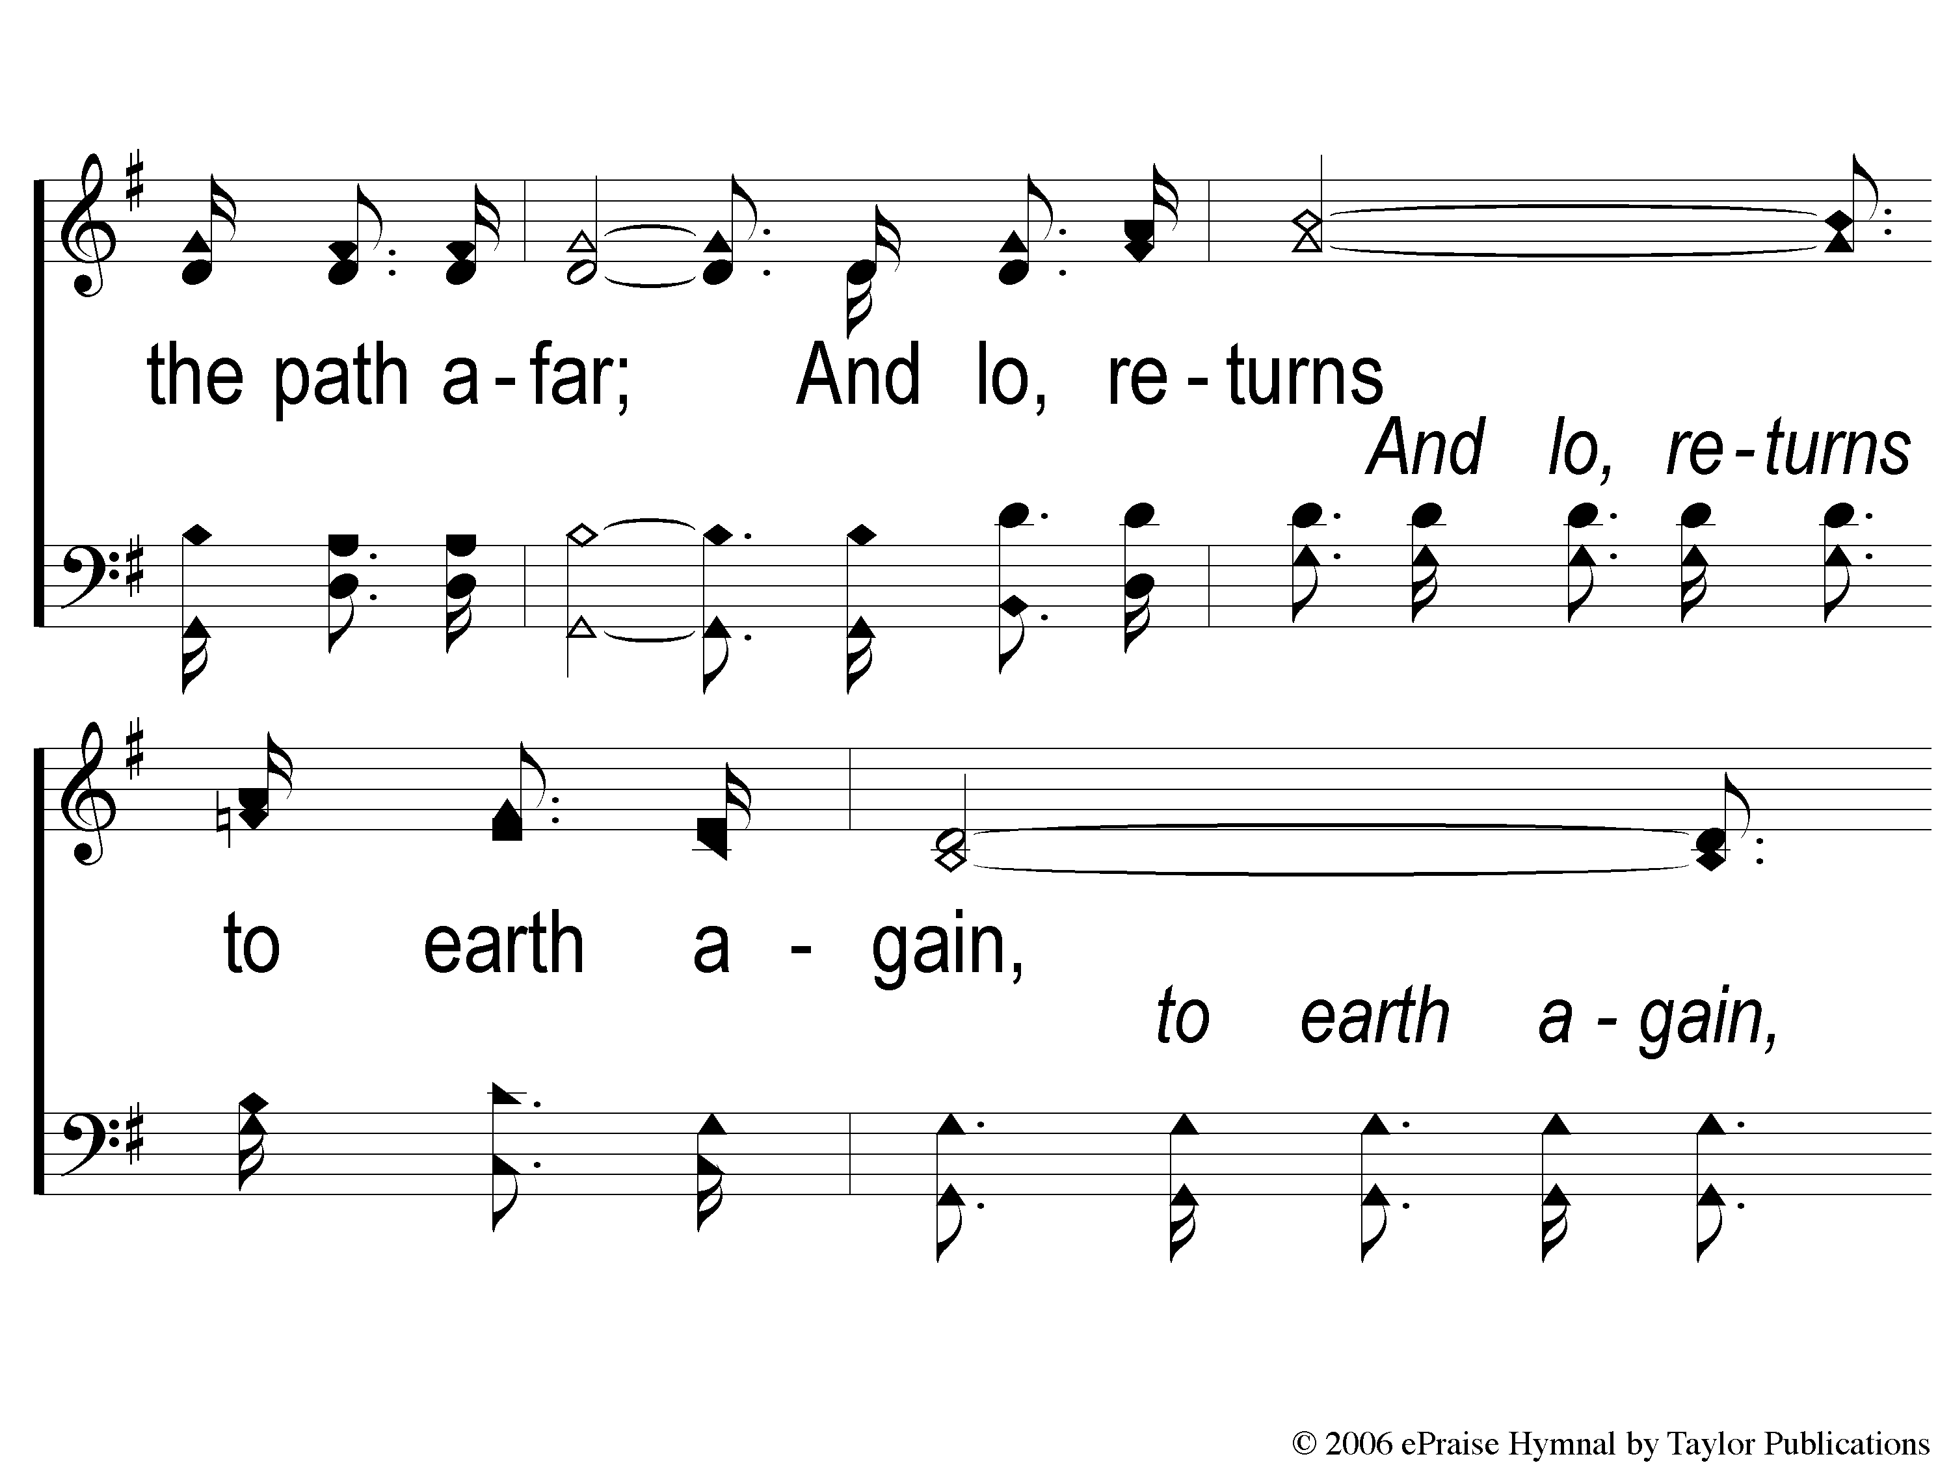
4-2 God Still Lives
God Still Lives
140

Slide 21
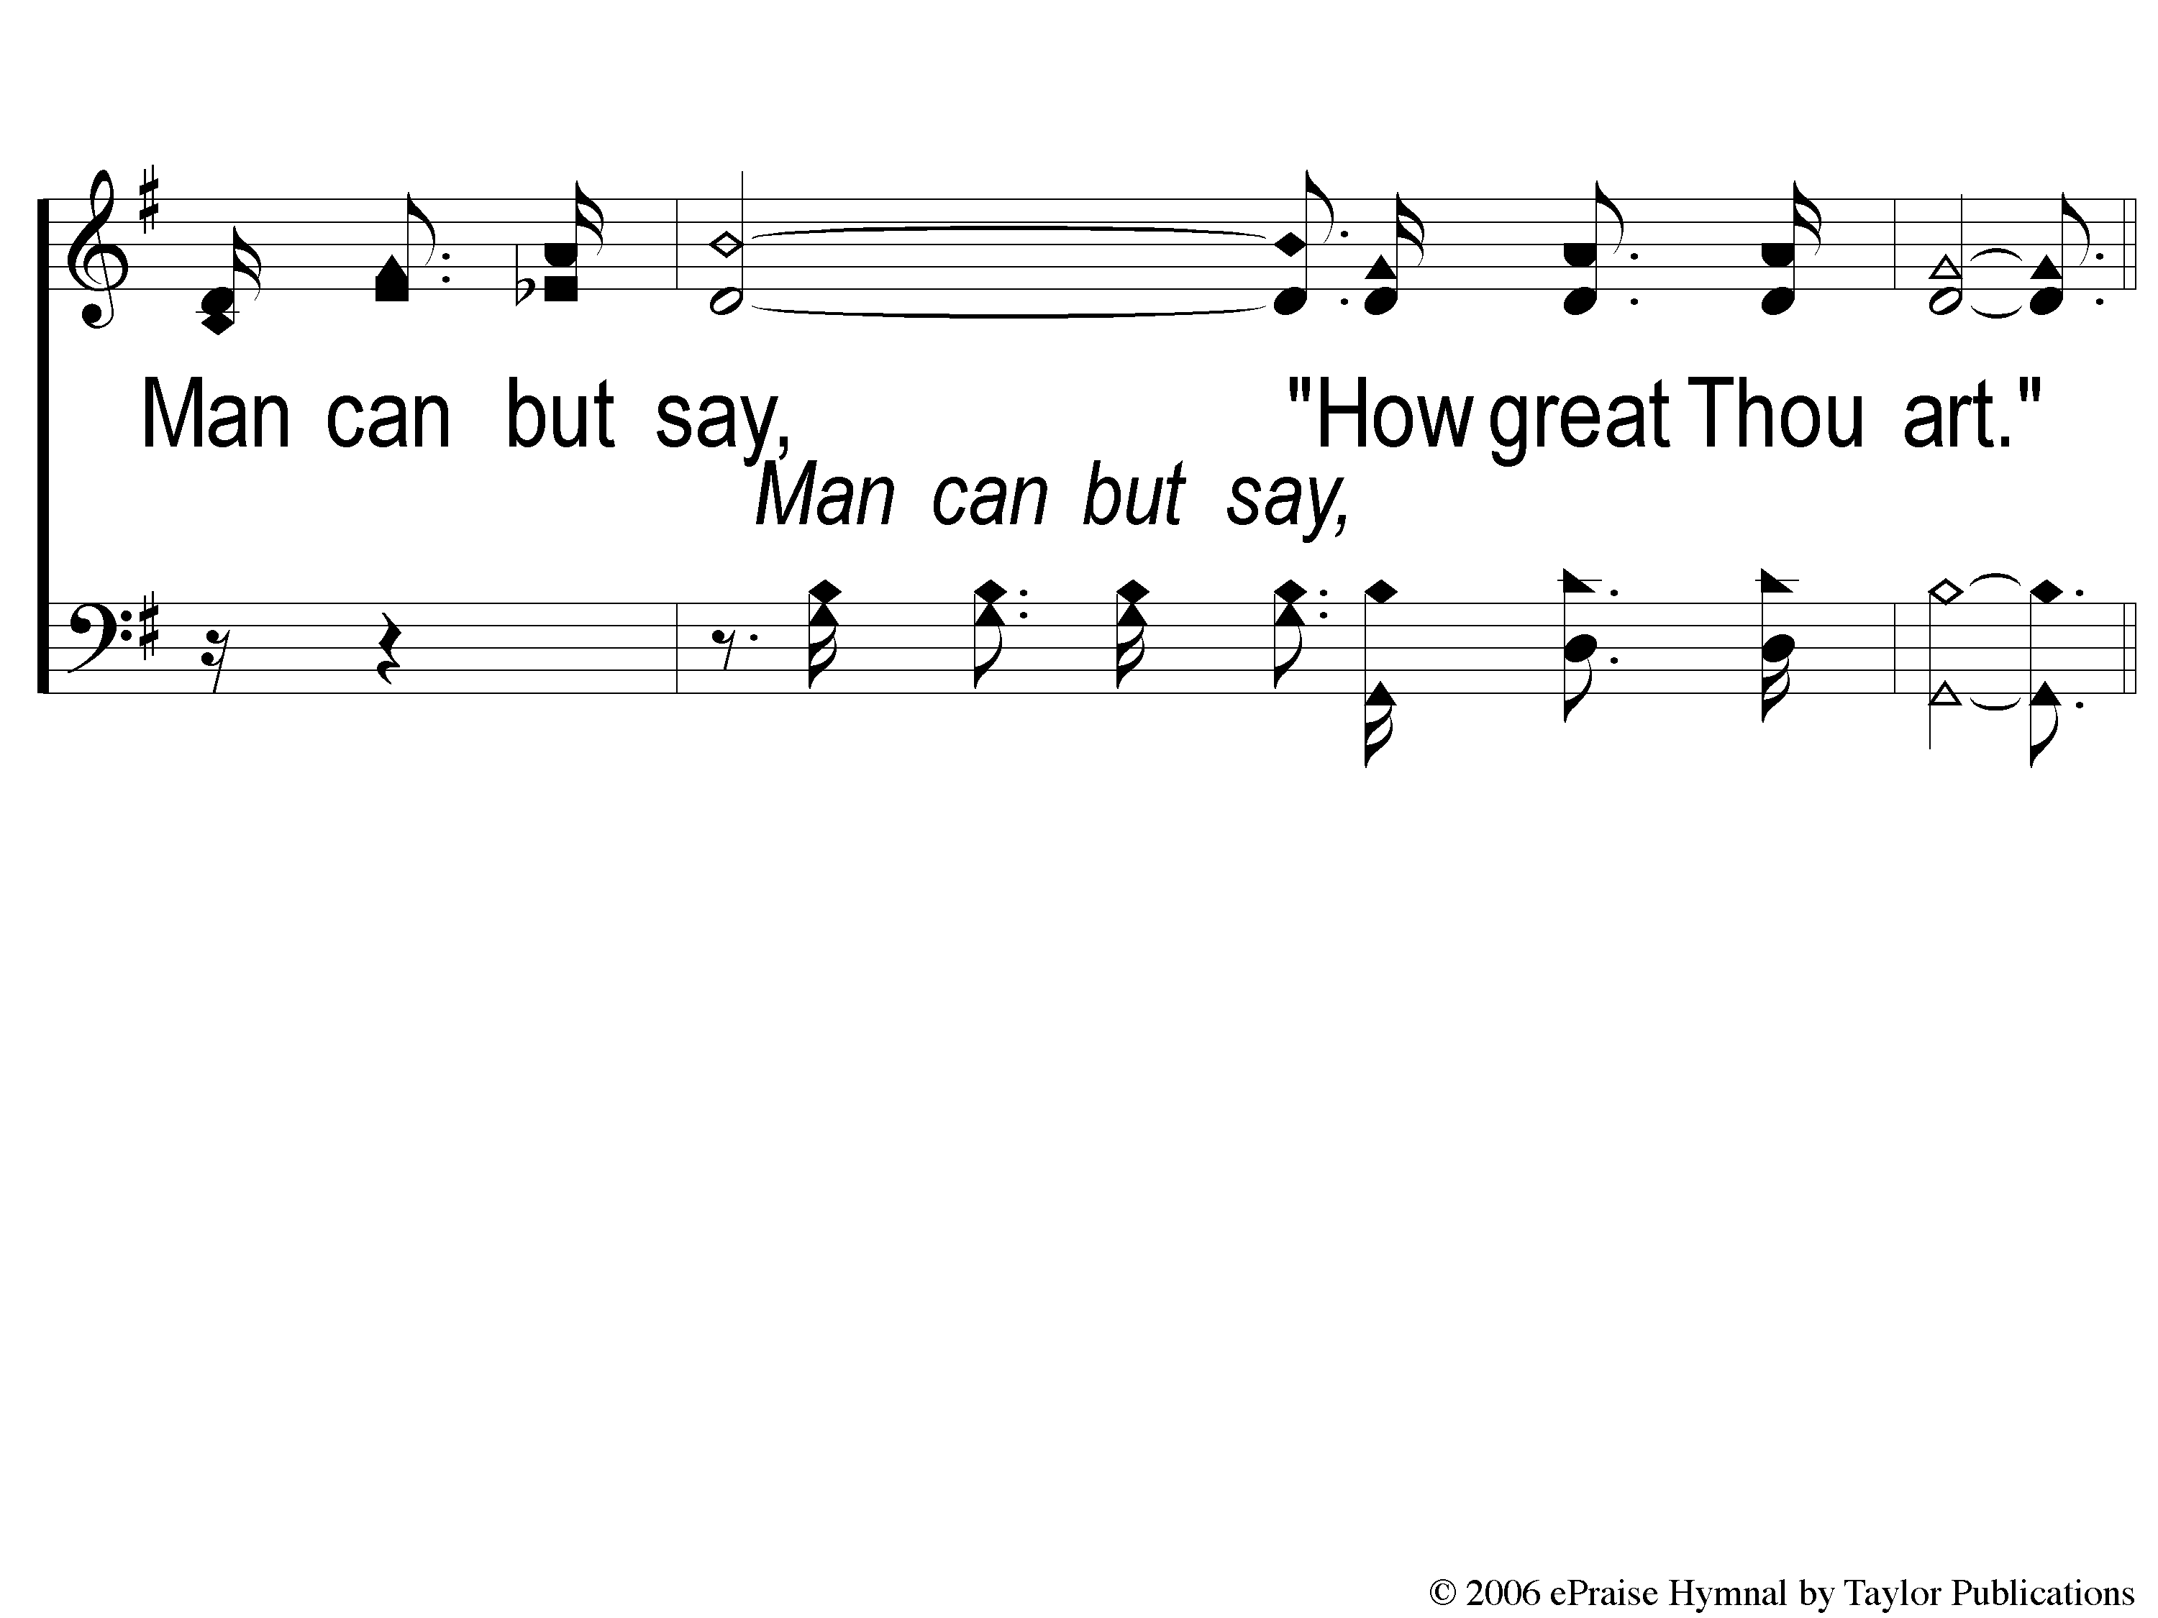
4-3 God Still Lives
God Still Lives
140

Slide 22
C-1 God Still Lives
God Still Lives
140

Slide 23
C-2 God Still Lives
God Still Lives
140

Slide 24
C-3 God Still Lives
God Still Lives
140

